Slide 1








T00 PHP + LARAGON
w
bit.ly/fstmtube

Slide 2




3-tier
Tier3 : Database
Tier1 : Client/browser
Tier2 : Middleware (Webserver + PHP)

Slide 3


T1: CLIENT (BROWSER HTML)
The User-interface

Slide 4

T2: Web server + PHP interpreter
Hold logic/ business process
Server-side scripting
Dynamic web

Slide 5

T3: DATABASE
Place to hold database/records/data

Slide 6

LARAGON.ORG
Development stack
https://laragon.org/download.html
Apache/ Nginx / PHP/ MySQL / NodeJS / etc…

Slide 7
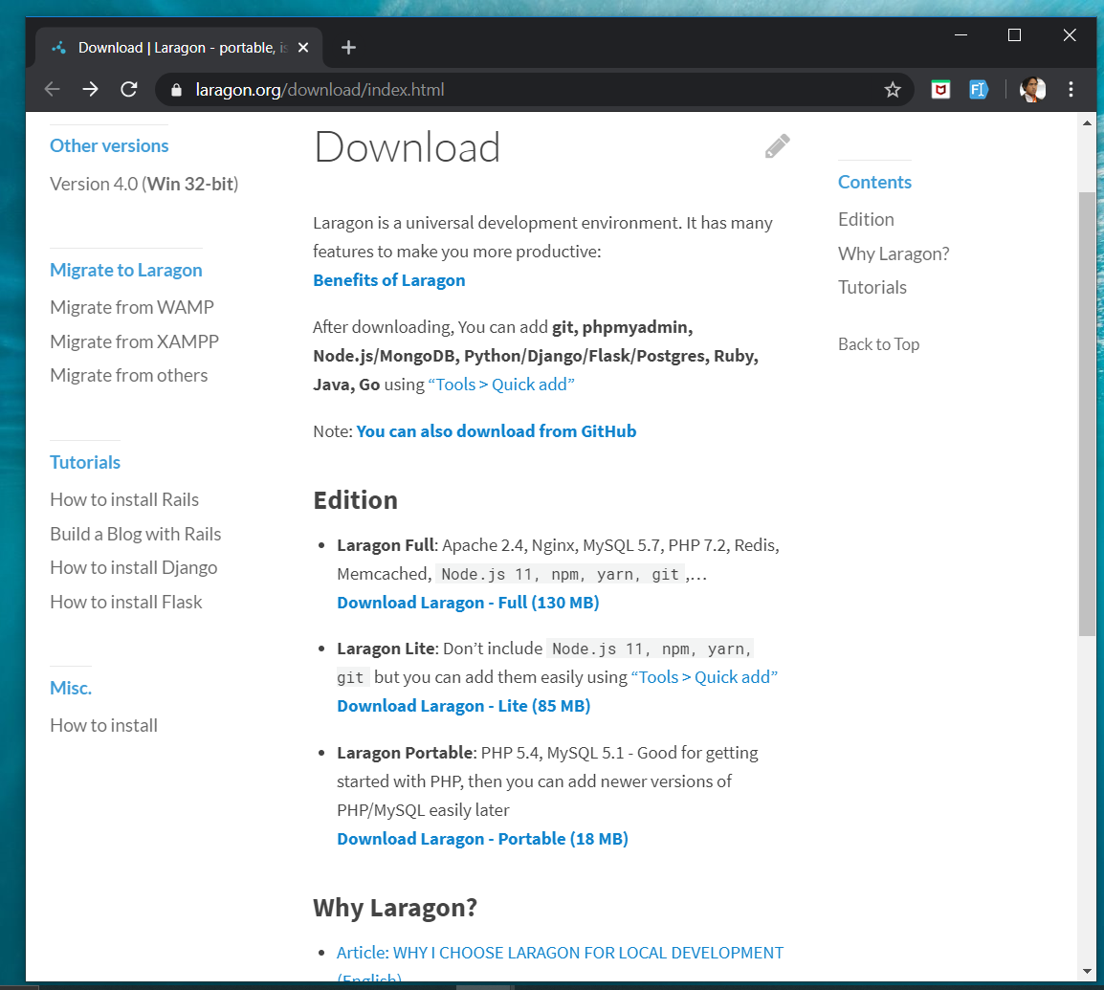
DOWNLOAD FROM LARAGON.org
Laragon.org

Slide 8
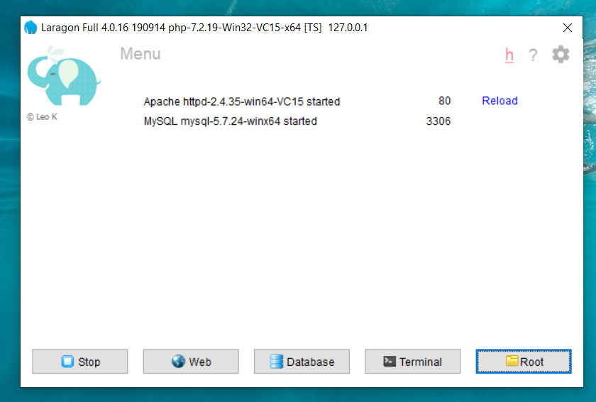
LARAGON INTERFACE
Start/stop servers
localhost
db client (HeidiSQL)
cli/npm/composer
go to webroot folder

Slide 9
T01 HTML5
w
bit.ly/fstmtube

Slide 10
Training outline
HTML5 – refers to the modern day of HTML which promotes native handling of video & audio & animation without having to install additional plugins to browser.
Bootstrap – A HTML framework supports responsive web design to provide one time webpage development for smartphone, tablet and desktop.

Slide 11
HTML5
HTML5 – refers to the modern day of HTML which promotes native handling of video & audio & animation without having to install additional plugins to browser.
<!DOCTYPE html>
Try: https://www.w3schools.com/html/tryit.asp?filename=tryhtml_headings

Slide 12
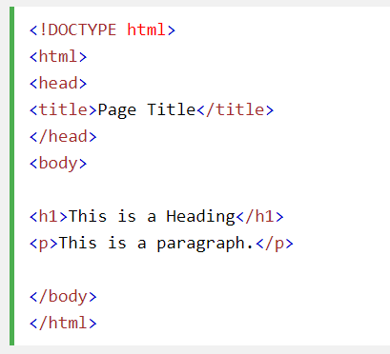
Typical HTML CODE

Slide 13
HTML5 image handling
<img src="pic_mountain.jpg" alt="Mountain View" style="width:304px;height:228px;">
Use width 100% to support responsive layout design.
Try: https://www.w3schools.com/html/tryit.asp?filename=tryhtml_images_trulli

Slide 14
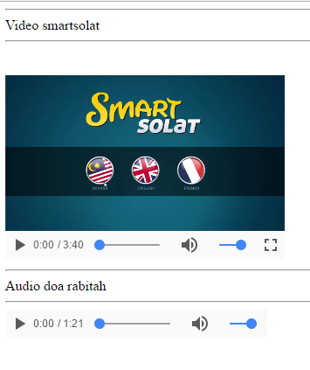
HTML5 Native video
<video width="320" height="240" controls> <source src="movie.mp4" type="video/mp4"> <source src="movie.ogg" type="video/ogg"> Your browser does not support the video tag. </video>
Try: https://www.w3schools.com/html/tryit.asp?filename=tryhtml5_video

Slide 15
HTML5 Native AUDIO
<audio controls> <source src="horse.ogg" type="audio/ogg"> <source src="horse.mp3" type="audio/mpeg"> Your browser does not support the audio element. </audio>

Slide 16
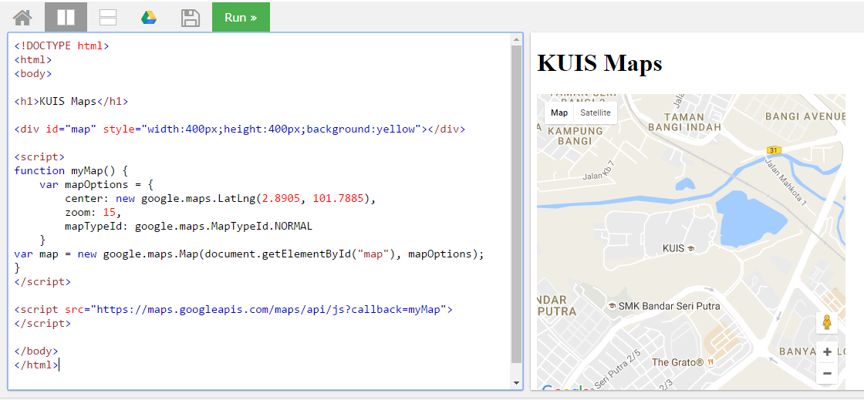
Location MAPS

Slide 17
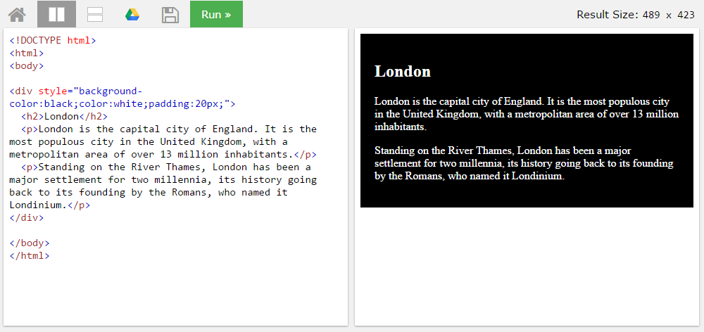
BLOCK <DIV>

Slide 18
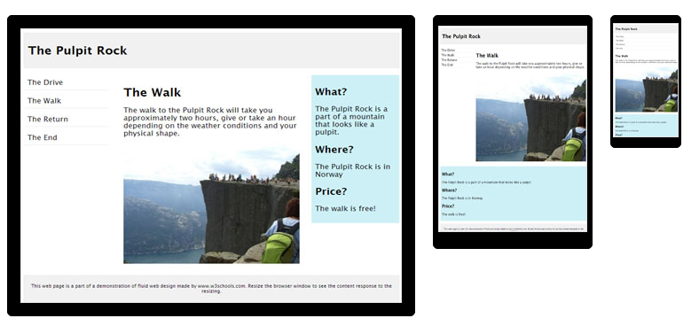
HTML Responsive layout

Slide 19
HTML Responsive layout
What is Responsive Web Design?
Responsive Web Design makes your web page look good on all devices (desktops, tablets, and phones).
Responsive Web Design is about using CSS and HTML to resize, hide, shrink, enlarge, or move the content to make it look good on any screen

Slide 20
VIEWPORT
<meta name="viewport" content="width=device-width, initial-scale=1">
The viewport varies with the device, and will be smaller on a mobile phone than on a computer screen.
The initial-scale=1.0 part sets the initial zoom level when the page is first loaded by the browser.

Slide 21
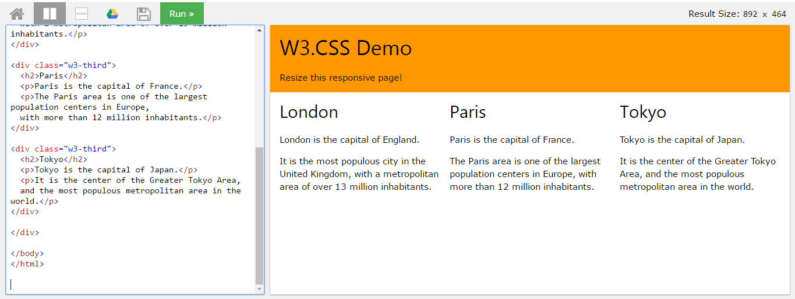
HTML Responsive layout

Slide 22
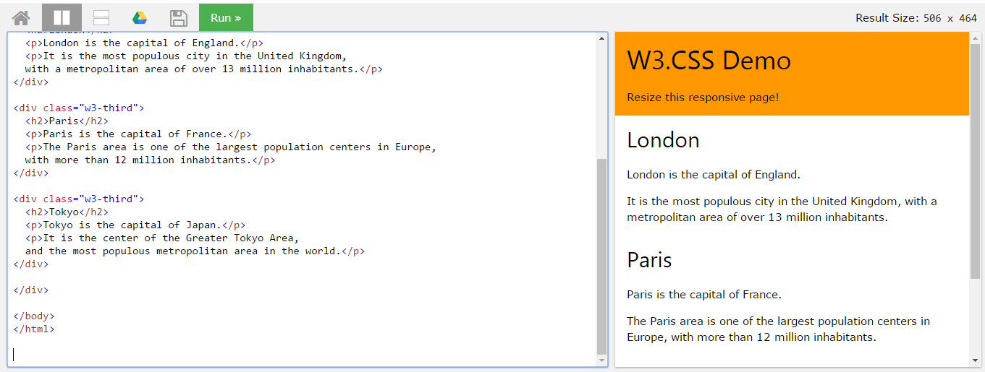
HTML Responsive layout

Slide 23
T02 BOOTSTRAP + PHP include
w
bit.ly/fstmtube

Slide 24

Bootstrap
A HTML framework supports responsive web design to provide one time webpage development for smartphone, tablet and desktop.

Slide 25
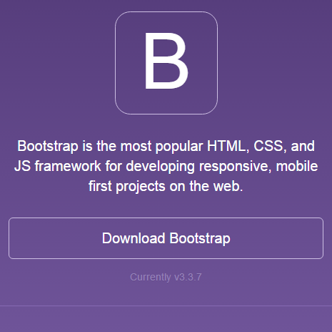
Bootstrap
Download framework from getbootstrap.com
OR use the CDN

Slide 26
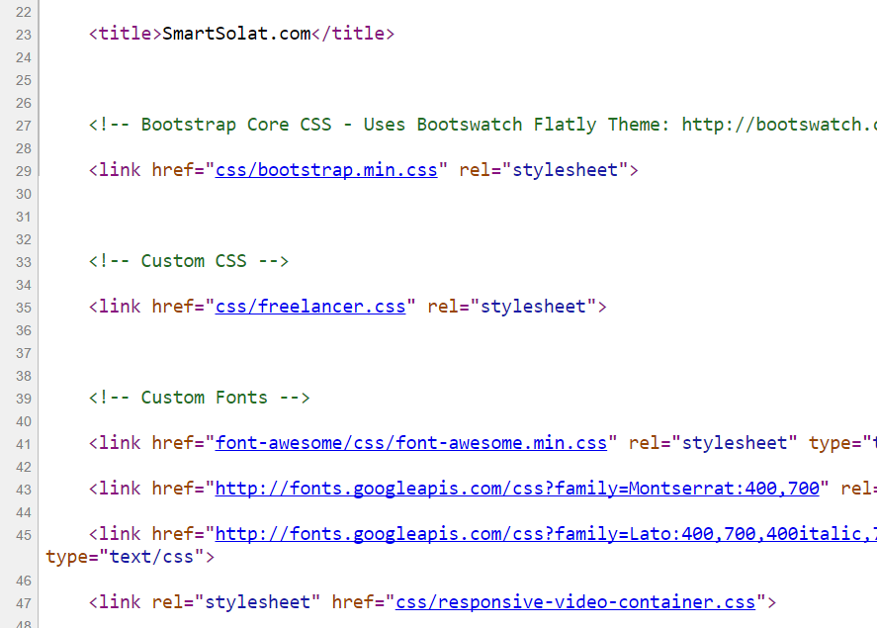
Bootstrap -setting
Copy the CSS script to the project folder.
> OR we can use CDN server

Slide 27
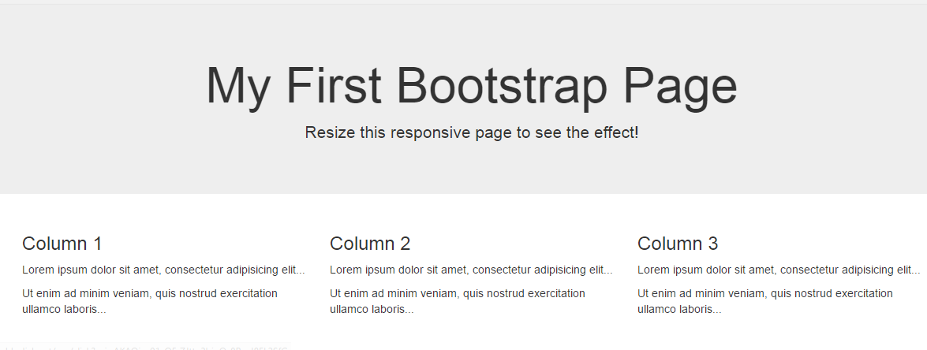
Basic bootstrap layout
Try it here http://www.w3schools.com/bootstrap/tryit.asp?filename=trybs_default&stacked=h

Slide 28
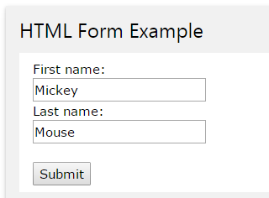
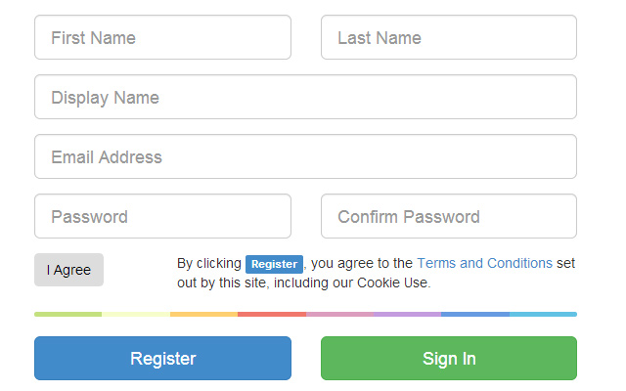
BOOTSTRAP FORM

Slide 29
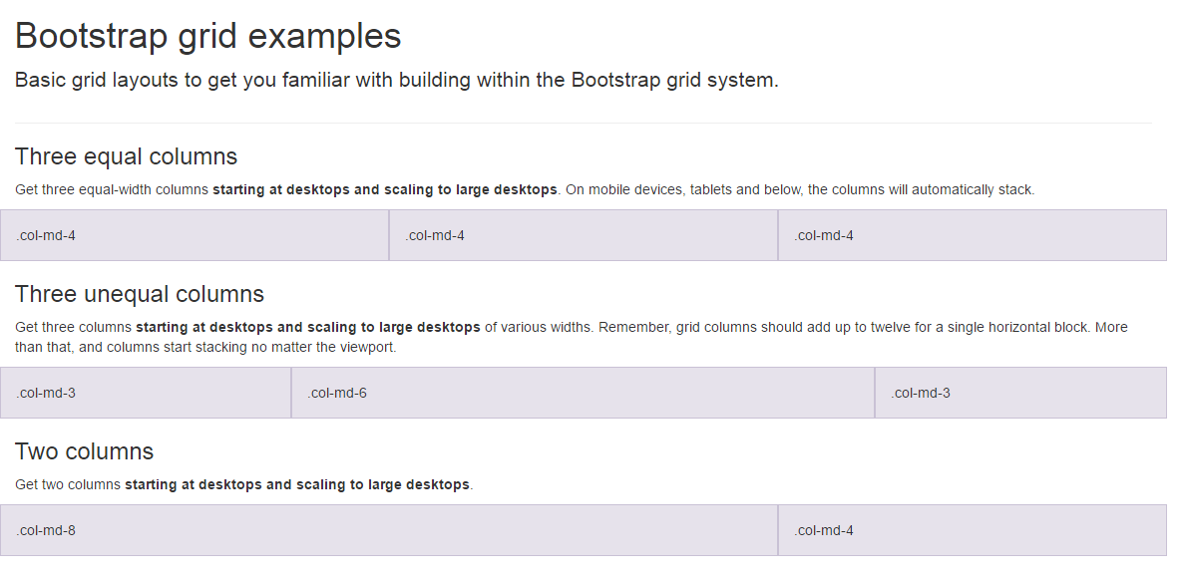
BootSTRAP GRID SYSTEM

Slide 30
BootSTRAP GRID SYSTEM DESKTOP
Banner
Main Content
Sidebar
Footer

Slide 31
BootSTRAP GRID SYSTEM MOBILE
Banner
Main Content
Sidebar
Footer

Slide 32
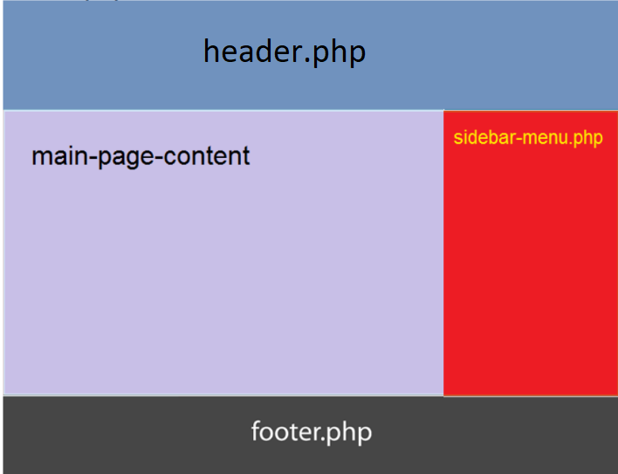
Include php
include (“header.php”);
<our content>
include (“footer.php”);

Slide 33

FREE STARTbootstrap.com
Example https://startbootstrap.com/

Slide 34
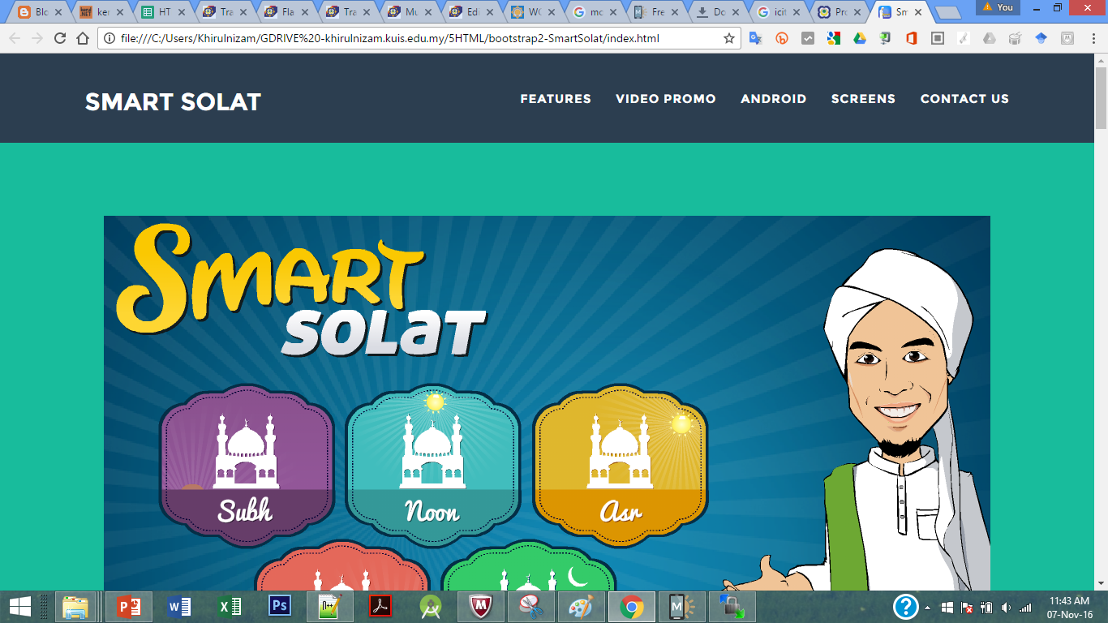
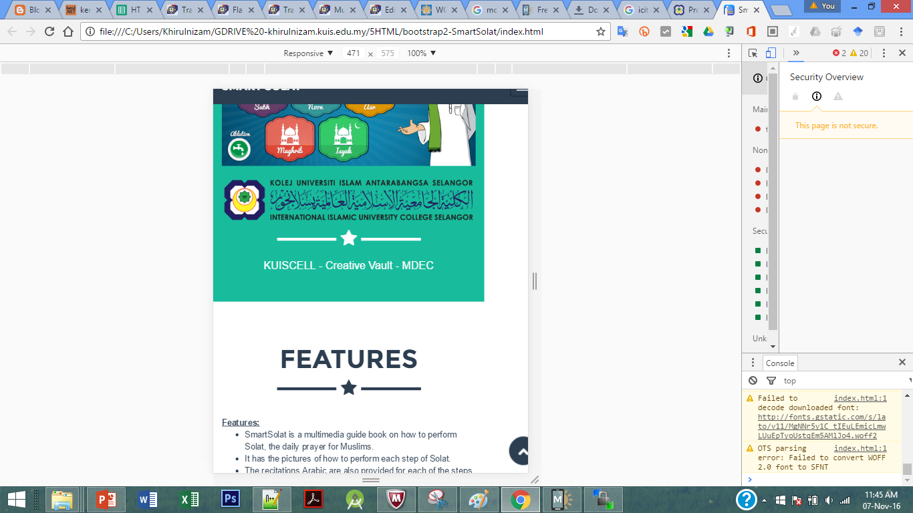
Sample2 - smartsolat

Slide 35
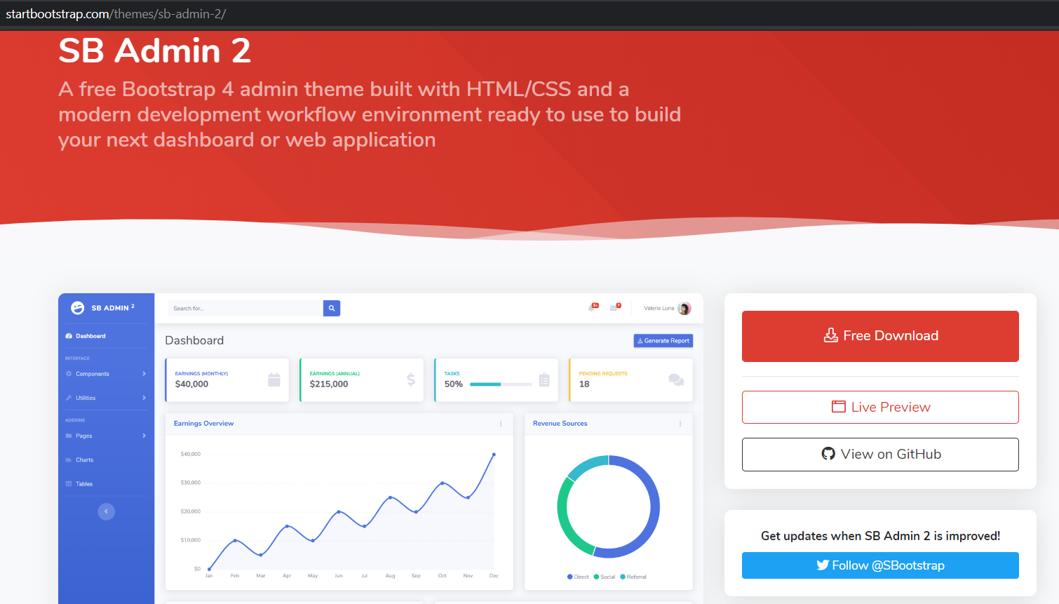
startbootstrap.com/themes/sb-admin-2/

Slide 36
T03: PHP SYNTAX & ECHO
w
bit.ly/fstmtube

Slide 37

Introduction
What is Web programming:
Combination of server-side and client-side to develop a dynamic website.
The application is deployed in the Web environment and can be access by multiple concurrent users.

Slide 38
Introduction to PHP
PHP= PHP: Hypertext Preprocessor:
Is a server-side scripting language.
PHP scripts are executed on the server, and the output from the process is inserted to the Web page as a part of the content before transmitted to the browser.
The script will not be sent to the browser which request the Web page, so the script is not visible to the users.

Slide 39
Introduction to PHP
Server-side Scripting | Client-side scripting
The script embedded inside the HTML page, interpreted and executed inside the server (the web server) and the result/output of the execution is sent to the browser. The script interpreted and executed inside the server. E.g.: PHP, ASP. | The script embedded inside the HTML page, downloaded with the HTML page and executed on the client (browser). E.g.: JavaScript.

Slide 40
Introduction to PHP
Why PHP?
Runs on different platforms (Windows, Linux, Unix, etc.).
Is compatible with almost all servers used today (Apache, IIS, etc.).
Is free to download.
Is easier to learn and runs efficiently on the server side.

Slide 41
PHP Script Tag
A PHP scripting block always starts with <?php and ends with ?>
A PHP scripting block can be placed anywhere in the document.
On servers with shorthand support enabled ( enable in php.ini) may start a scripting block with <? and end with ?>

Slide 42
PHP Script Tag
A PHP file normally contains HTML tags, just like an HTML file, and some PHP scripting code.
Next, we have an example of a simple PHP script which sends the text “Assalamualaikum" to the browser:

Slide 43
PHP Script Tag
<html>
<head>
<title> Web Programming </title>
</head>
<body>
<?php
echo "Assalamualaikum";
?>
</body>
</html>

Slide 44
PHP Script TAG
Each code line in PHP must end with a semicolon ( ; ).
The semicolon is a separator and is used to distinguish one set of instructions from another.

Slide 45
PHP Script Tag
There are two basic statements to output text with PHP: echo and print.
In the example before, we have used the echo statement to output the text "Assalamualaikum".

Slide 46
PHP ECHO
<?php
$txt="Assalamualaikum!";
$x=23;
echo "Assalamualaikum!";
echo $x;
?>

Slide 48
T04 SYNTAX PHP COMMENTS & VARIABLE
w
bit.ly/fstmtube

Slide 49
Comments in PHP
Comment is remark inside code that will not be compiled (ignored when the program is compiled).
It will not effect the code.
It is a good practice to write the comment.
Comment is useful the tell others what is the program is doing.
Helps programmer to memorize what is he doing.

Slide 50
Comments in PHP
In PHP, we use:
// to make a single-line comment or
/* … */ to make a large comment block.

Slide 51
Comments in PHP
<html>
<head>
<title> Web Programming </title>
</head>
<body>
<?php //This is a comment /* This is a comment block */ ?>
</body>
</html>

Slide 52
T05 SYNTAX PHP VARIABLES & CONCAT
w
bit.ly/fstmtube

Slide 53
PHP Variables
Variables are used for storing values, like text strings, numbers or arrays.
When a variable is declared, it can be used over and over again in your script.
All variables in PHP start with a $ sign symbol.
The correct way of declaring a variable in PHP:
Eg: $var_name = "Kerul";

Slide 54
PHP Variables (cont)
New PHP programmers often forget the
$
sign at the beginning of the variable.
In that case it will not work.
Let's try creating a variable containing a string and a variable containing a number:

Slide 55
PHP Variables (cont)
<?php
$txt="Assalamualaikum!";
$x=23;
echo $txt;
?>

Slide 56
EXAMPLE ON VARIABLE
Write the echo( )statement to display the following message:
Assalamualaikum!23

Slide 57
Naming Rules for Variables
A variable name must start with a $
A variable name can only contain alpha-numeric characters and underscores (a-z, A-Z, 0-9, and _ ).
A variable name should contain no space.
If a variable name is more than one word, it should be separated with an underscore ($my_string), or with capitalization ($myString).

Slide 58
EXAMPLE
Decide whether the following variables are valid or invalid. Give your reason.
$apa 11) $my_books
$123lekuk 12) $_myFamily
$what-is-the-number 13) $my address
$_uji1 14) $my2numbers
$my name
$For
IF
$float
$variable_to_hold_names_or_matrix_for_students
$hasil*nombor

Slide 59
Lateral Values
Lateral is the exact/actual value.
The value could be number (integer or real), character, string, or Boolean.

Slide 60
Lateral Values (cont)
Integer:
Integer is round number.
For example, 10 is an integer.
E.g.:
$num = 10;
$num = -10;
Use negative sign for negative numbers.

Slide 61
Lateral Values (cont)
Float:
E.g.:
$temp = 21.1225;
$product = 0.0;

Slide 62
Lateral Values (cont)
Characters:
To assign a character value into a char variable, the value must be put inside a open and close single or double quote.
E.g.:
$nama = 'Encik';
$name = "Kerul";

Slide 63
Lateral Values (cont)
Boolean:
There are only two values for Boolean variable: true and false.
E.g.:
$eatalready = true;
$isInteger = false;

Slide 64
Lateral Values (cont)
String:
A group of characters.
Marked with single or double quote.
E.g.:
$stmt = "How are you";

Slide 65
Concatenation Operator
There is only one string operator in PHP.
The concatenation operator ( . ) is used to put two string values together.
To concatenate two string variables together, use the concatenation operator:

Slide 66
Concatenation (cont)
<?php $txt1="Assalamualaikum!"; $txt2="Have a nice day!";
echo $txt1 . " " . $txt2; ?>

Slide 67
Concatenation (cont)
The simpler way in doing concatenation:
<?php $txt1="Assalamualaikum!"; $txt2="Have a nice day!";
echo "$txt1 $txt2"; ?>

Slide 68
Concatenation (cont)
Or, if you want to print the output in a separate line:
<?php $txt1="Assalamualaikum!"; $txt2="Have a nice day!";
echo "$txt1 <br> $txt2"; ?>

Slide 69
Concatenation (cont)
Array:
<?php $num[0]=3;
echo "Number ".$num[0];
echo "Number $num[0] ";//not possible
?>

Slide 70
T05+1 INPUT PROCESS OUTPUT
w
bit.ly/fstmtube

Slide 71
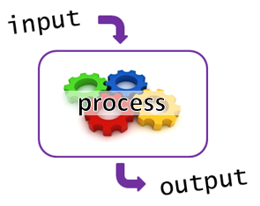
I-P-O
Input data
Process the data by converting into information
Output – convey the information as something meaningful

Slide 72
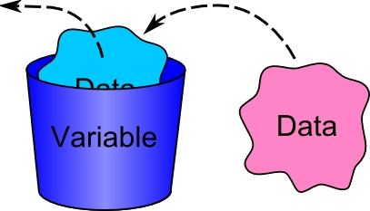
PHP Variables
Variables are used for storing values, like text strings, numbers or arrays.
All variables in PHP start with a $ sign symbol.
The correct way of declaring a variable in PHP:
Eg: $num1= 4; $num2=5;

Slide 73
Naming Rules for Variables
A variable name must start with a $
A variable name can only contain alpha-numeric characters and underscores (a-z, A-Z, 0-9, and _ ).
A variable name should contain no space.
If a variable name is more than one word, it should be separated with an underscore ($my_string), or with capitalization ($myString).

Slide 74
PROCESS: ADD 2 NUMBERS
Input process output
$num2 3
$num1 5
$total 8

Slide 76
T06 FORM INPUT
w
bit.ly/fstmtube

Slide 77
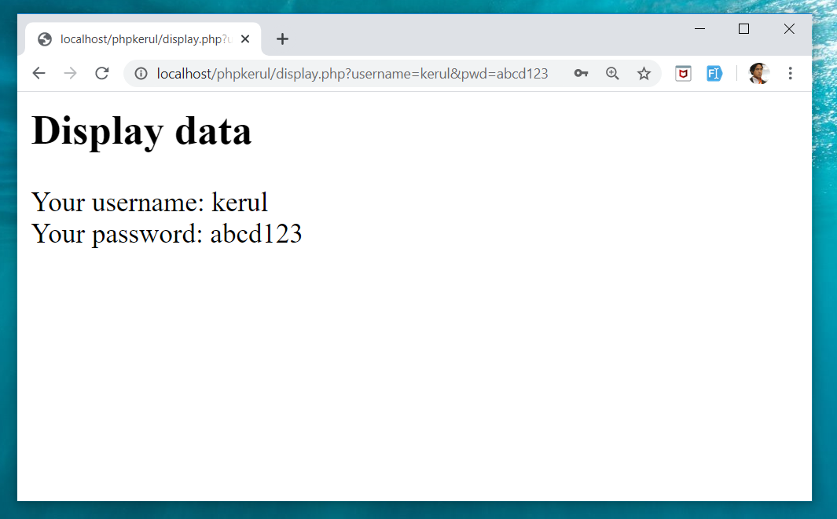
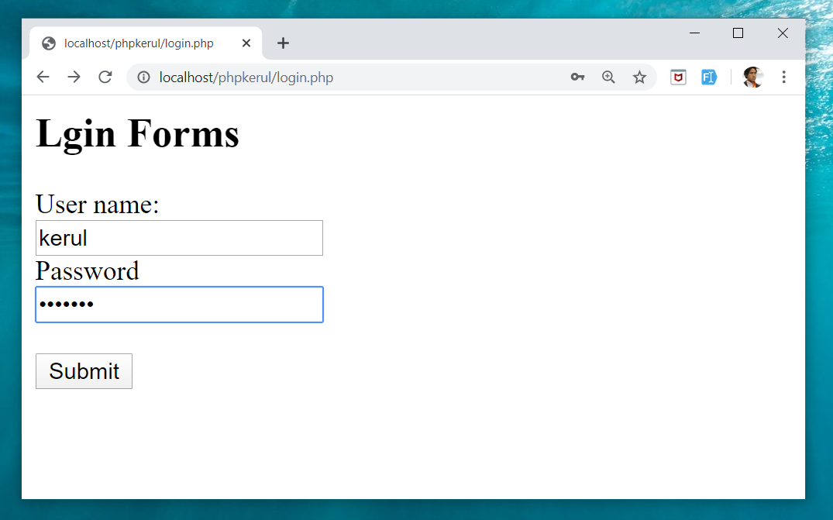
Example (cont)

Slide 78
Input Through HTML
<form name=“aform” method=“GET” action=“save.php”>
input…
</form>
This is the typical structure of form:
name: is the name of the form.
method: how the data is transferred (POST or GET).
action: is the target file resides in the Web server that receive the data from the form.
input: are the input elements (text field, checkbox, radio button, etc.).

Slide 79
GET vs. POST
GET | POST
Is basically for just getting (retrieving) data. The variable name and the value appear and visible in the URL. Form data is to be encoded (by a browser) into at the end of the URL of the target file. | Form data is embedded within a message body. POST may involve anything, like storing files to the server, updating data, ordering a product, or sending an e-mail. The variable name and the value do not appear in the URL.

Slide 80
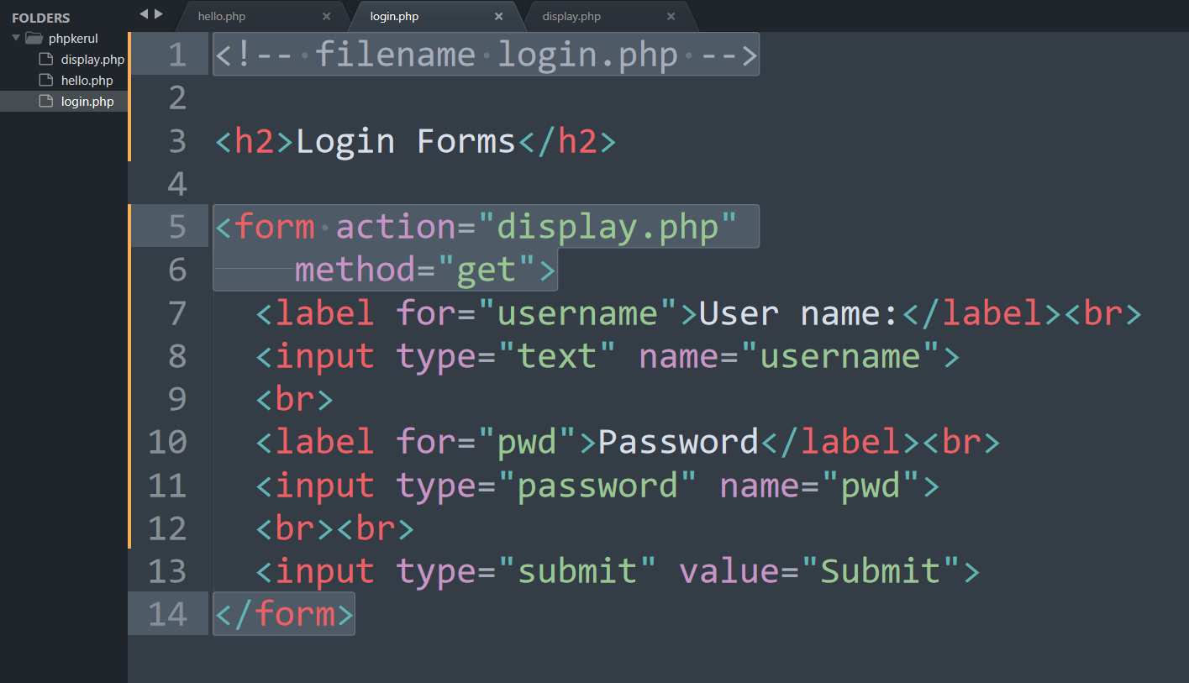
Example (Using GET Method)

Slide 81
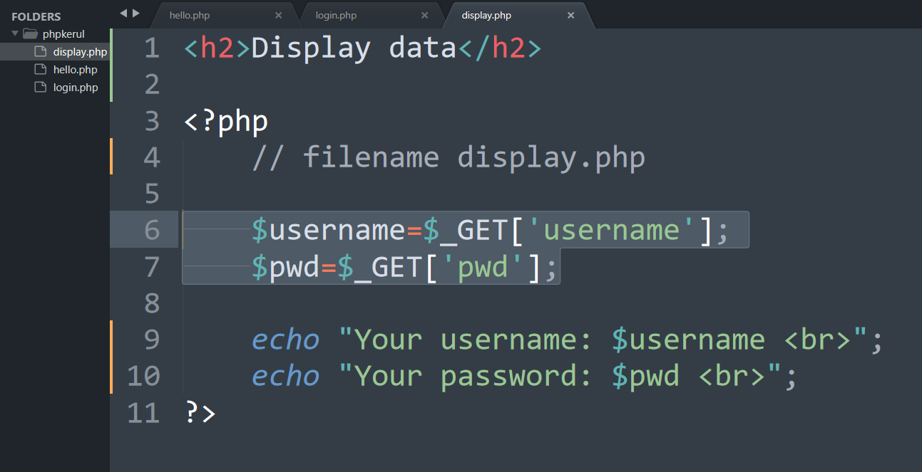
Display.php

Slide 82
Example (cont)

Slide 83
Example (Using POST Method)

Slide 84
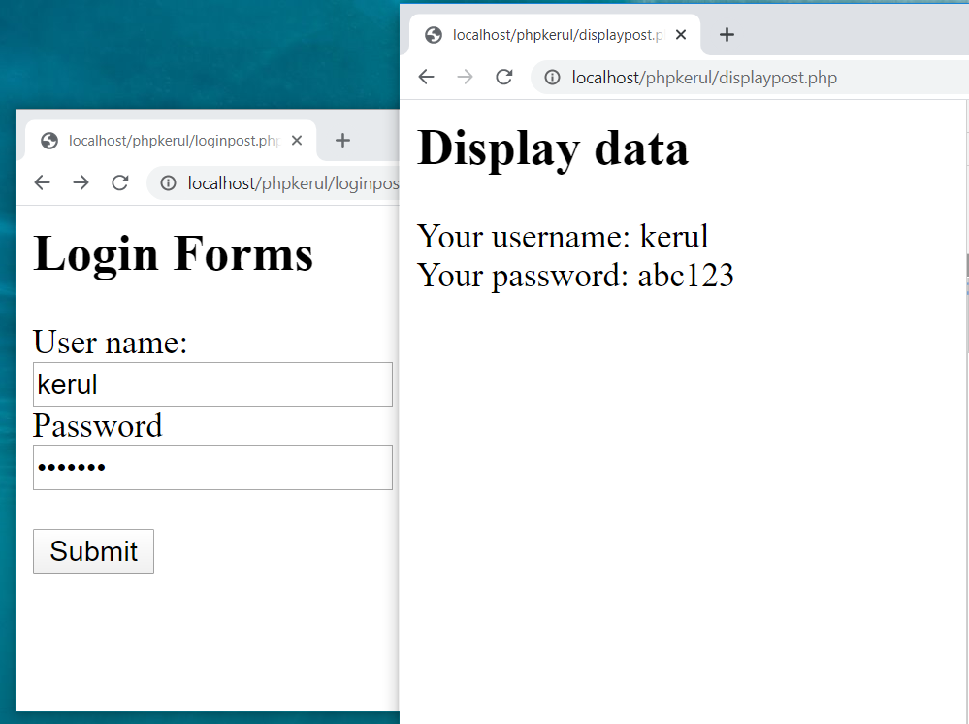

Slide 85
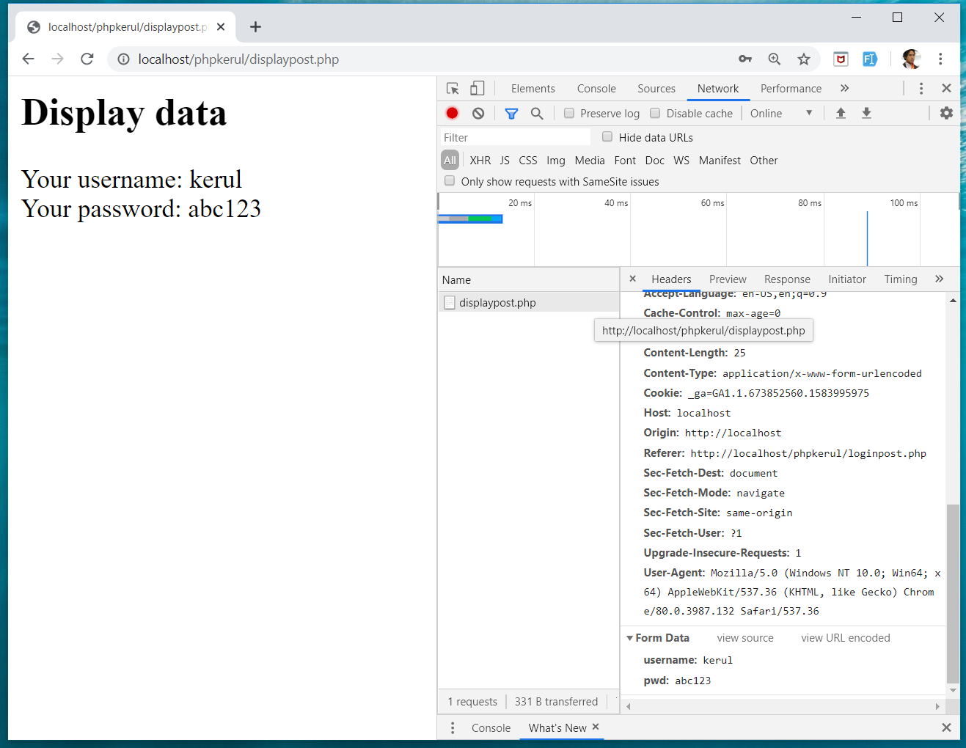
INSPECT TOOLS
F12

Slide 86
T07 SELECTION (PILIHAN) IF…Else
w
bit.ly/fstmtube

Slide 87
Comparison Operators
Operator | Meaning | Example
== | Equal to | ($num == 100)
!= | Not equal to | ($letter != ‘Z’)
< | Less than | ($num1 < $num2)
> | Greater than | ($mark > 80)
<= | Less than or equal to | ($sum <= 10)
>= | Greater than or equal to | ($sum >= $input)

Slide 88
Selection in PHP
if is a PHP reserved words to perform selection:
Simple if: for one choice selection
if…else: for two choices selection

Slide 89
Simple if
E.g.:
if ($grade == 'A')
echo 'Excellent';
else if ($grade == 'F')
echo 'Try again’;
else

Slide 90
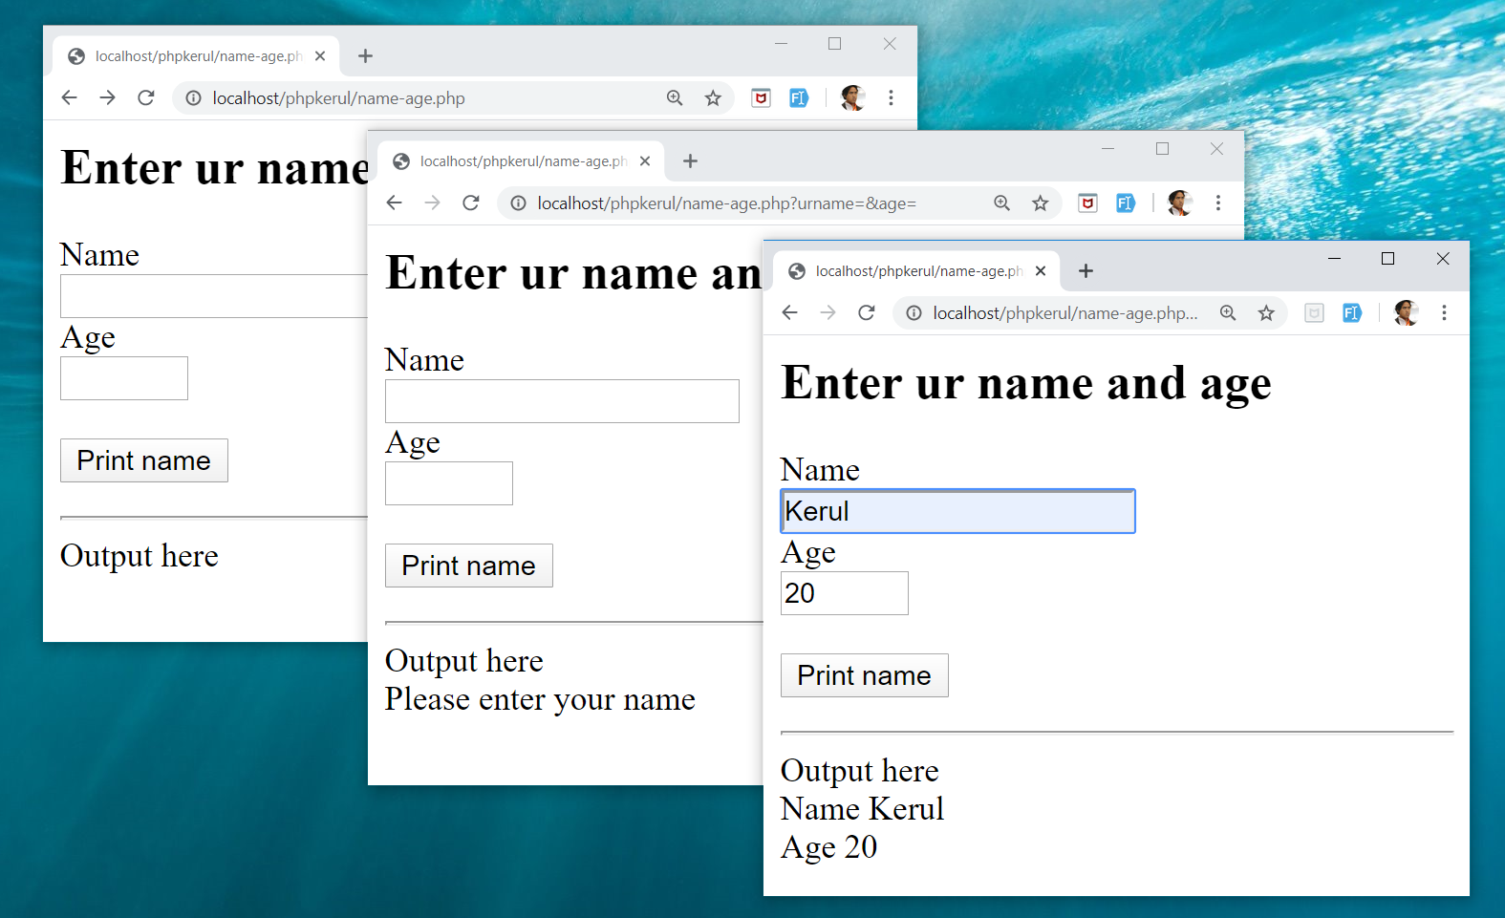
Example

Slide 91
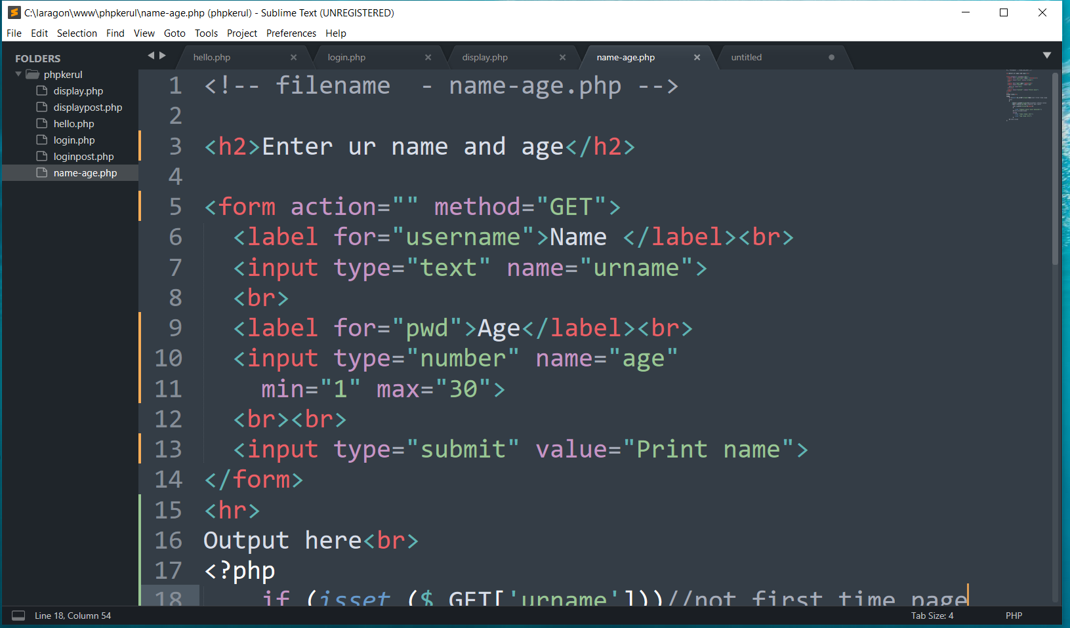
FORM (name-age.php )

Slide 92
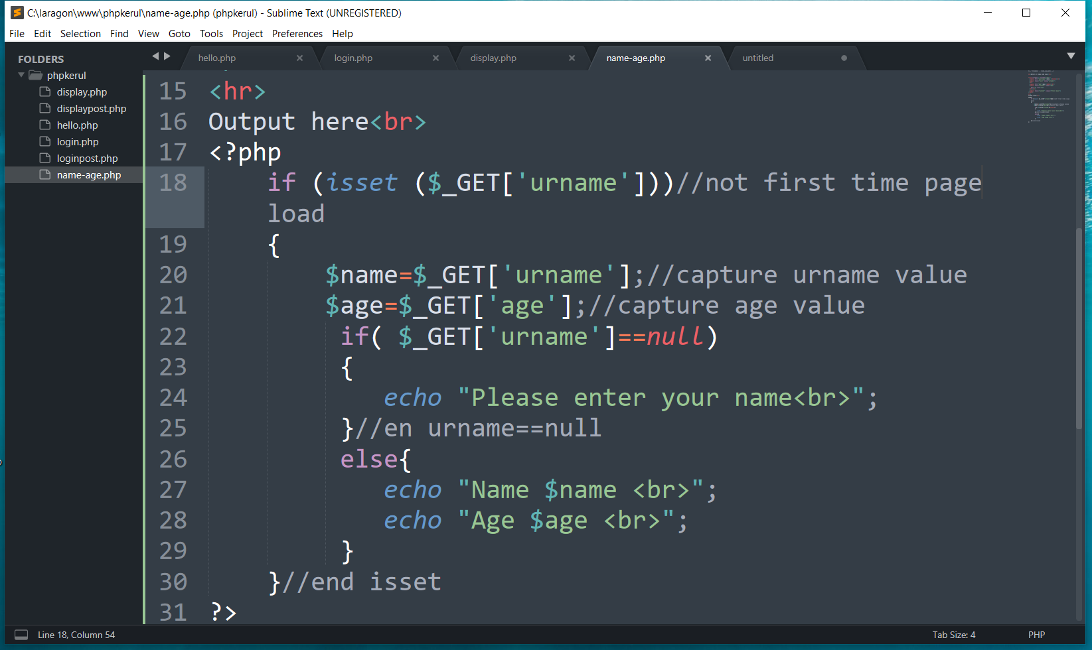
THE PHP IF…ELSE

Slide 93
T08 ITERATION (ULANGAN) FOR LOOp
w
bit.ly/fstmtube

Slide 94
Repetition in PHP
There are many ways of doing repetition. Three of them:
for
while and do…while
foreach

Slide 95
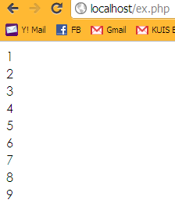
for structure
E.g.:
<?php
for ($i=1; $i<=9;$i++){
echo "$i<br>";
}
?>

Slide 96
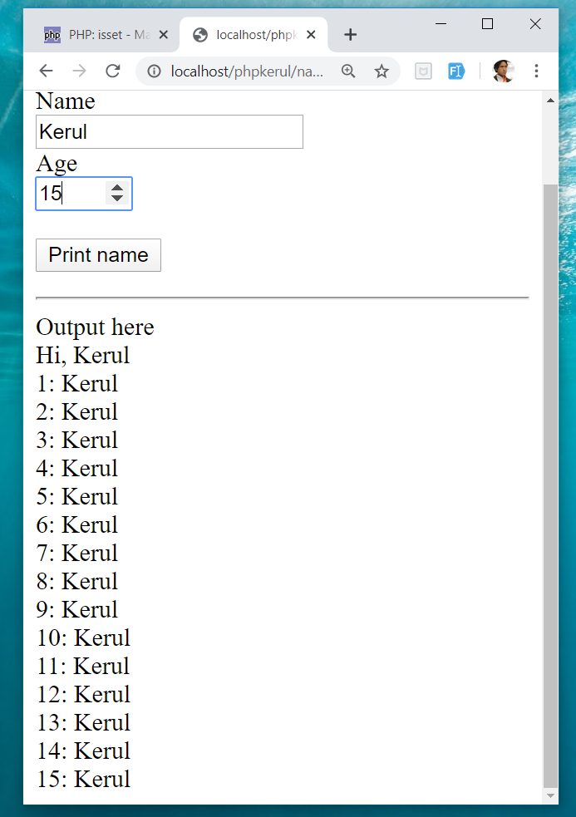
OUTPUT SAMPLE

Slide 97
T09 ARRAY (TATASUSUNAN) FOREACH
w
bit.ly/fstmtube

Slide 98
Introduction of Array
A variable is a storage area holding a number or text. The problem is a variable hold only one value.
An array is a special variable, which can store multiple values in one single variable.

Slide 99
Introduction of Array (cont)
If you have a list of items (a list of student names, for e.g.), storing the student names in single variables could look like this:
$std1="Anas"; $std2="Hajar"; $std3="Shah";

Slide 100
Introduction of Array
In PHP, there are 3 kind of arrays:
Numeric array - An array with a numeric index.
Assign using AUTOMATIC method.
Assign using MANUAL method.
Associative array - An array where each ID key is associated with a value.
Multidimensional array - An array containing one or more arrays.

Slide 101
Numeric Array
Assign using AUTOMATIC method (the index starts at 0).
$std = array("Anas", "Hajar", "Shah", "Nurul");
Assign using MANUAL method.
$std[0]="Anas"; $std[1]="Hajar"; $std[2]="Shah"; $std[3]="Nurul";

Slide 102
Example
<?php
$std[0]="Anas";
$std[1]="Hajar";
$std[2]="Shah";
$std[3]="Nurul";
echo $std[0] . " and " . $std[1] . " are students of FSTM.";
?>

Slide 103
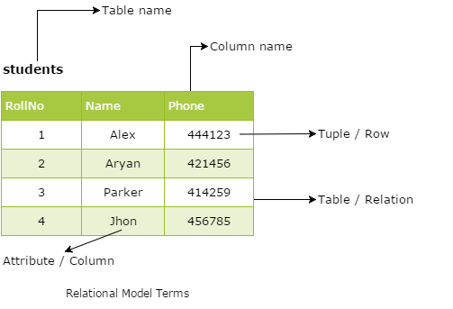
Associative Array
$record['rollno' ]=5;
$record['name']="Kerul";
$record['phone’]=90346;

Slide 104
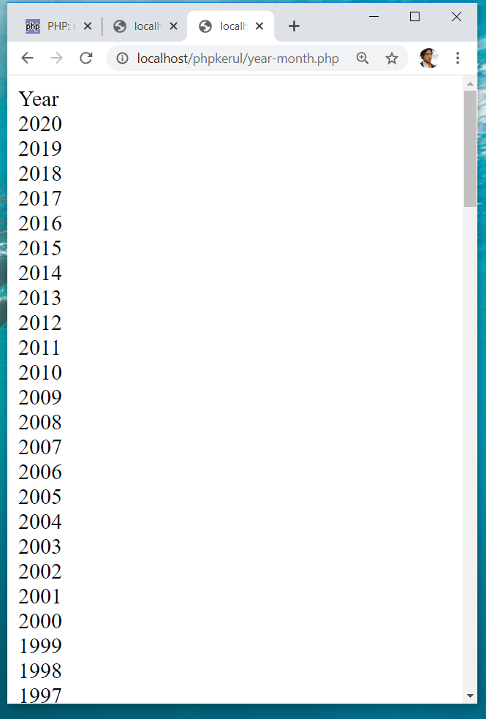
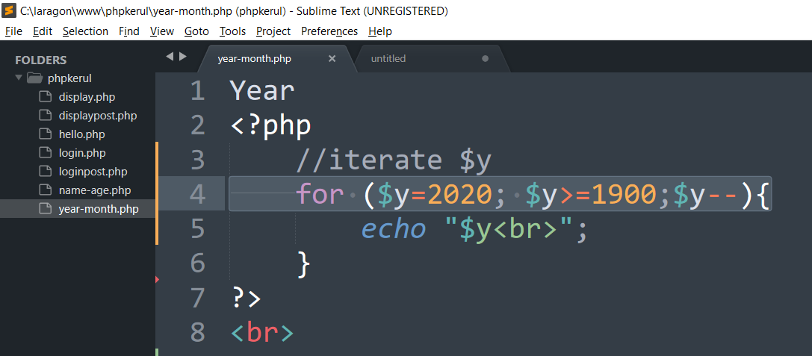
DISPLAY YEARS in DROPDOWN

Slide 105
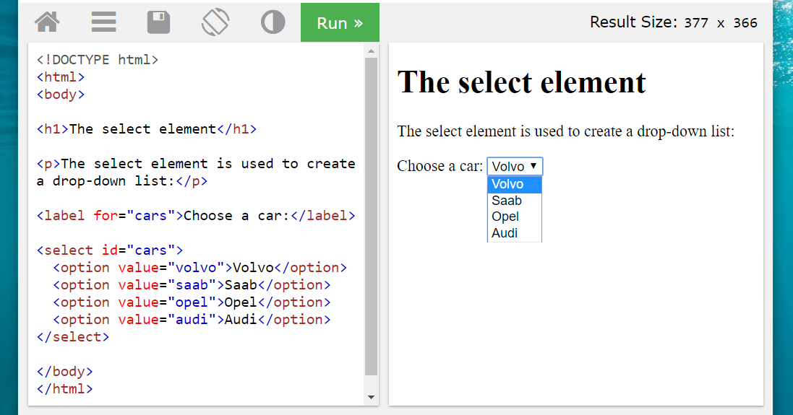
SELECT
OPTION

Slide 106
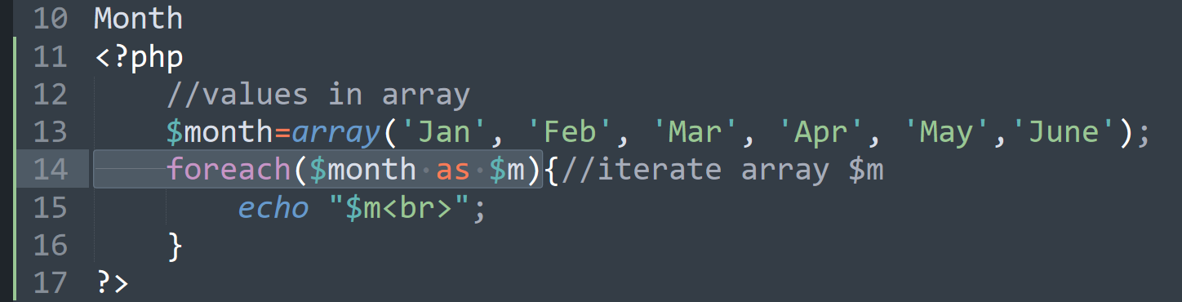
FOREACH

Slide 107
T10 FILE UPLOAD (MUAT-NAIK FAIL)
w
bit.ly/fstmtube

Slide 108
DISCLAIMER
Codes are for demo purposes. Example showed here are only to validate the proof of concepts. Security aspect the demonstrated examples are beyond the coverage of these tutorials. You are advised to explore / sought after advanced topics of PHP web programming as the issues are covered in the advanced level.

Slide 109
move_uploaded_file function
The move_uploaded_file() function moves an uploaded file to a new location.
This function returns TRUE on success, or FALSE on failure.
Syntax:
move_uploaded_file(file,newloc)
file: Specifies the file name.
newloc: Specifies the new location (destination) for the file.

Slide 110
PHP.ini
In php settings ( locate file php.ini from Laragon), turn-on the file upload
file_uploads = On

Slide 111
UPLOAD FORM (ONLY FOR IMAGE)
<!DOCTYPE html> <html> <body> <form action= "saveupload.php" method="post" enctype="multipart/form-data"> Select image to upload: <input type="file" name="fileToUpload" <input type="submit" value="Upload Image" name="submit"> </form> </body> </html>

Slide 112
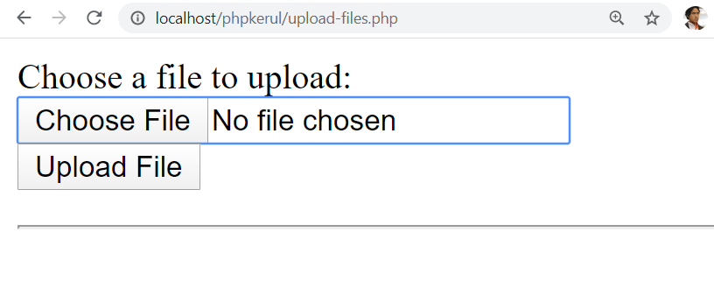
enctype
enctype="multipart/form-data" - POST request with file-upload, have to encode the data that forms the body of the request.
<input name="fileToUpload" type="file" > - the form control to choose a file and upload to server.

Slide 113
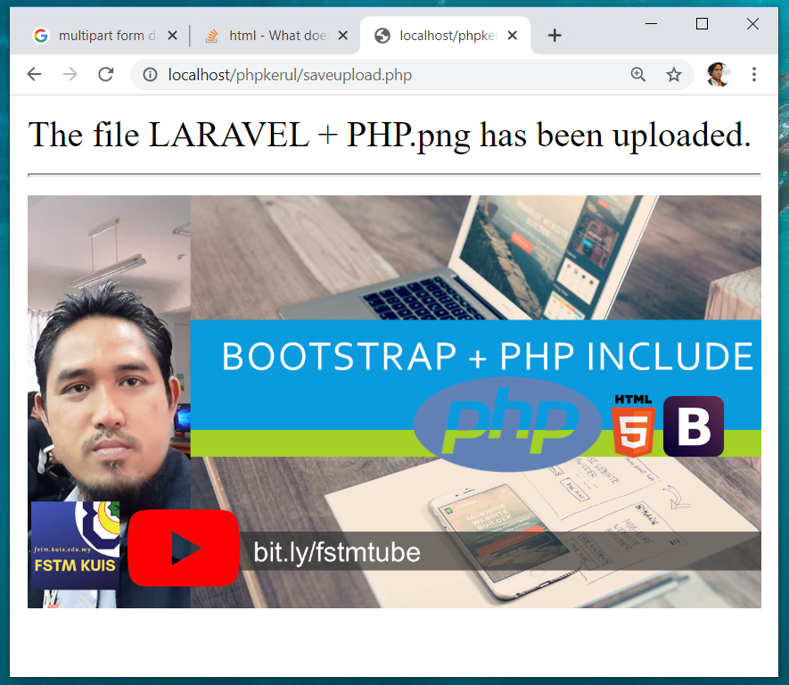
OUTPUT

Slide 114
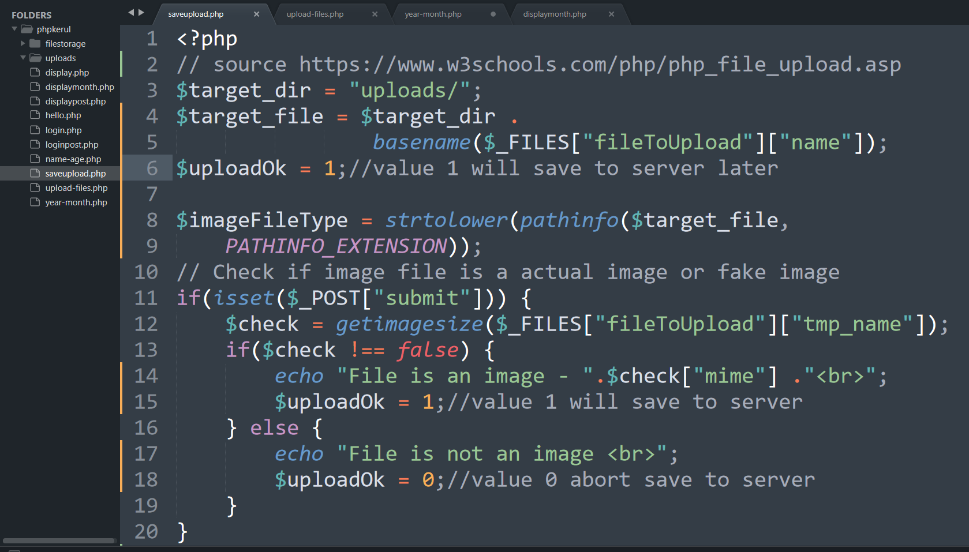
PHP to store image in server
Source: www.w3schools.com/php/php_file_upload.asp

Slide 115
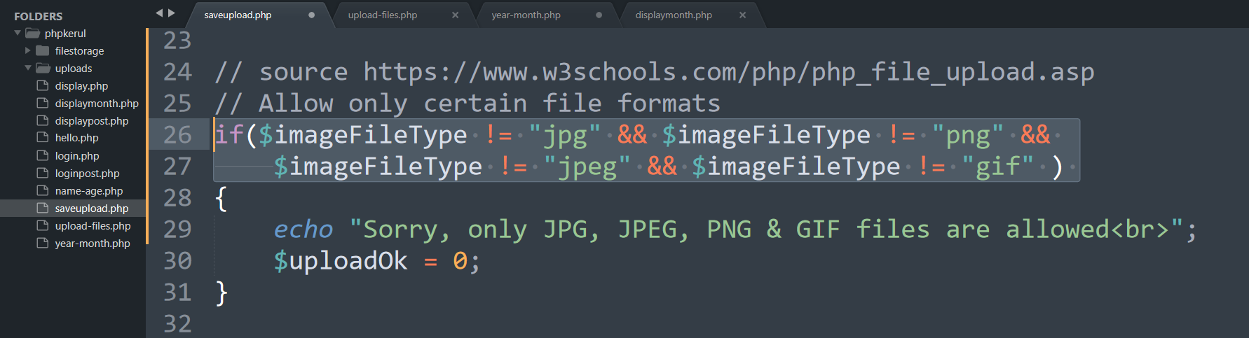
PHP to store image in server
Source: www.w3schools.com/php/php_file_upload.asp

Slide 116
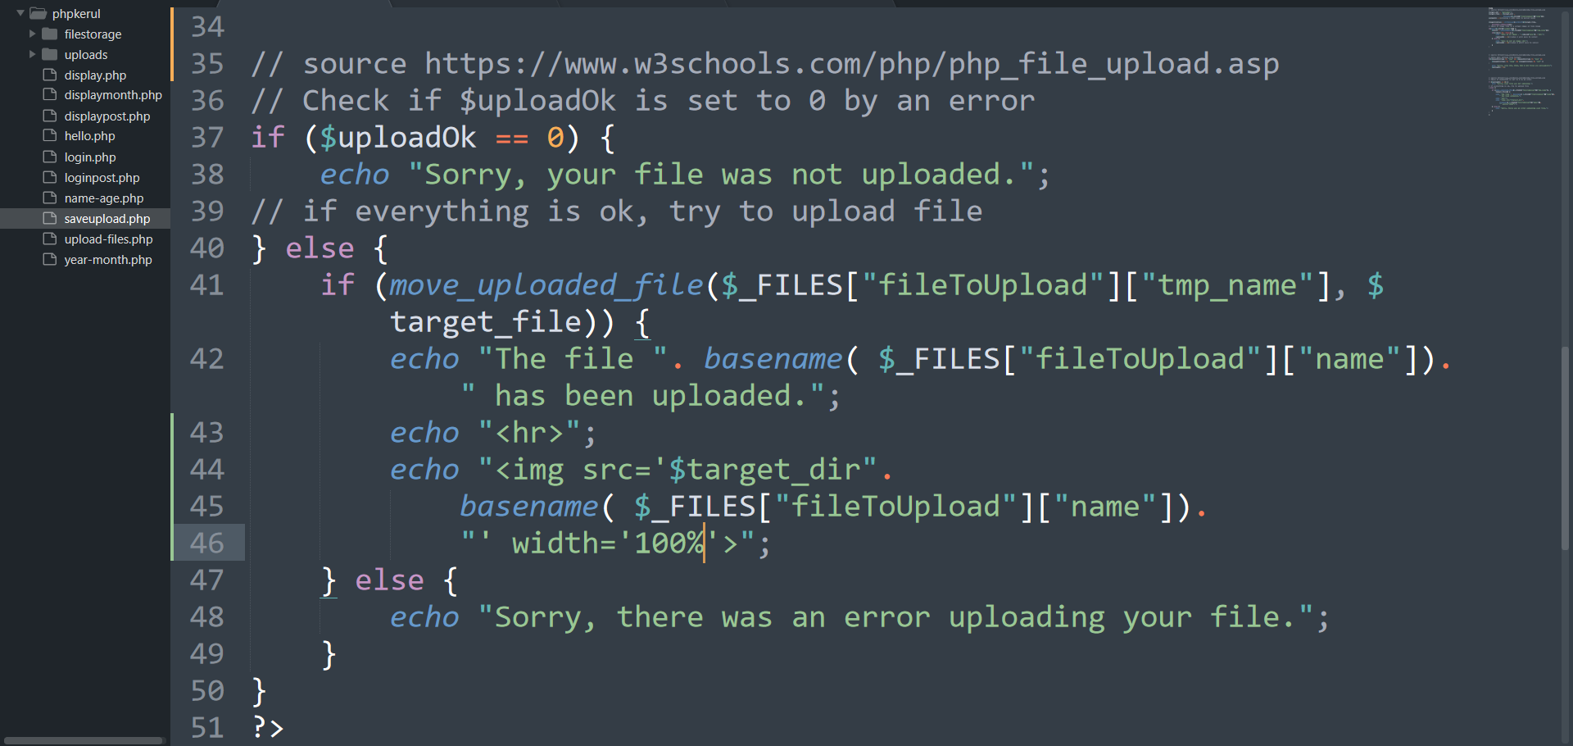
PHP to store image in server
Source: www.w3schools.com/php/php_file_upload.asp

Slide 117
OUTPUT

Slide 118
T11 php OOP (PENGATURCARAAN BERASASKAN OBJEK)
w
bit.ly/fstmtube

Slide 119
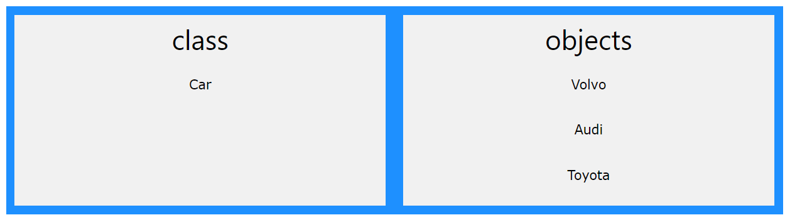

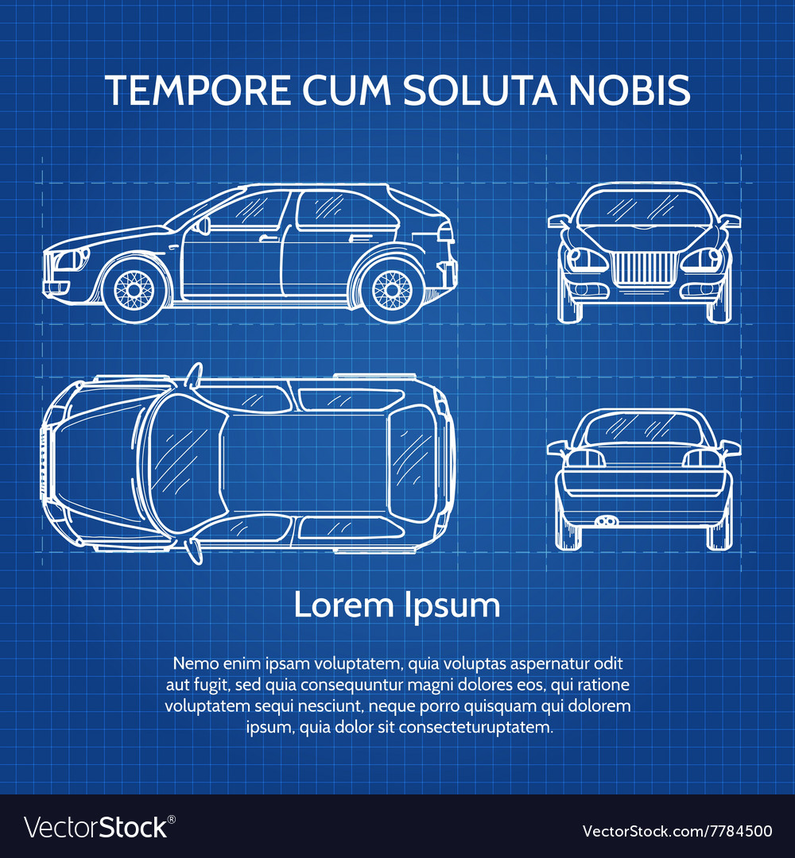

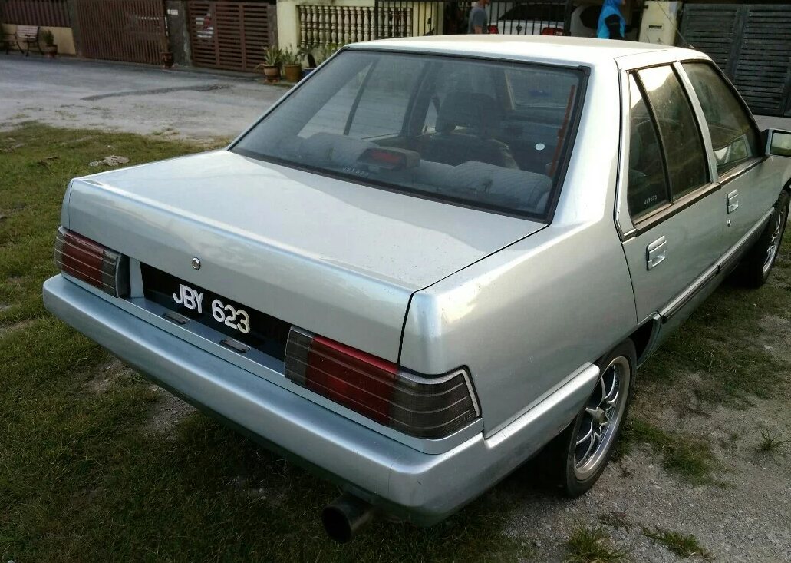
OOP
Object Oriented Programming - We can imagine our surroundings are full of objects cars, trees, houses, etc. Same way there is object oriented programming concepts which assume everything as an object and implement a software/system parts using different objects.
w3schools

Slide 120
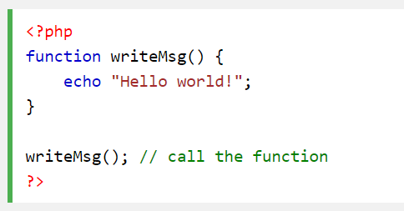
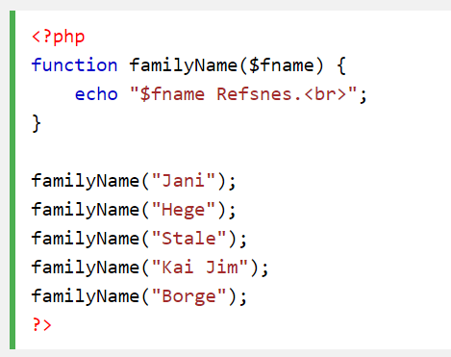
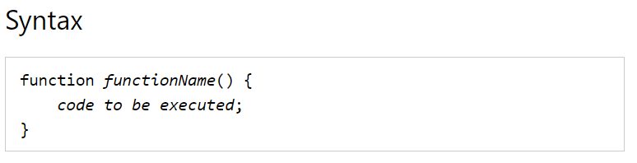
FUNCTION IN PHP
A function is a block of statements that can be used repeatedly in a program.
Without arguments.
With arguments.

Slide 121
MODULAR PHP FUNCTION
Tokenization
Post Tagging
Vocab
Outside Vocab
Annotati
Output generation
Input file

Slide 122
Class
PHP OOP
Methods
Properties
Classes and objects are the two main aspects of object-oriented programming.
Class
Method/function
Object call
Constructor
Static method/property
Inheritance

Slide 123
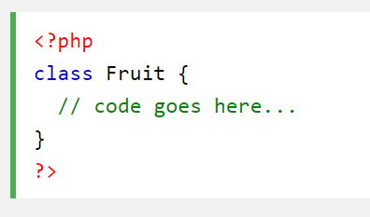
PHP Class

Slide 124
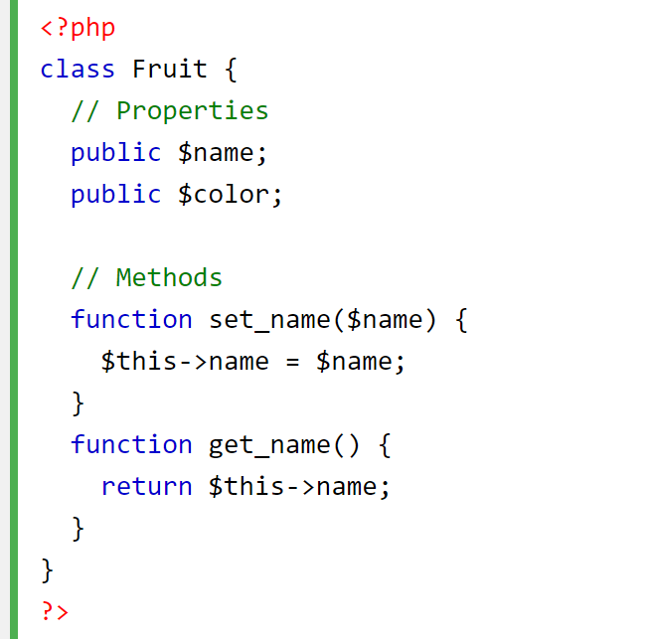
CLASS Method

Slide 125


PHP Class with Constructor

Slide 126
PHP Object Call

Slide 127


STATIC METHOD/PROPERTIES
w3schools

Slide 128

INHERITANCE
Inheritance in OOP = When a class derives from another class.
The child class will inherit all the public and protected properties and methods from the parent class. In addition, it can have its own properties and methods.
An inherited class is defined by using the extends keyword.
Parent /
Superclass
Child/Subclass

Slide 129

EXAMPLE ON INHERITANCE

Slide 130

INHERITANCE: PHP FRAMEWORK
bit.ly/fstmtubelaravel

Slide 131

T12 PREPARING MYSQL DATABASE SERVER (PANGKALAN DATA)
bit.ly/fstmtubephpmysql

Slide 132

T12 PREPARING MYSQL DATABASE SERVER (PANGKALAN DATA)
bit.ly/fstmtubephpmysql

Slide 133
DISCLAIMER
Codes are for demo purposes. Example showed here are only to validate the proof of concepts. Security aspect the demonstrated examples are beyond the coverage of these tutorials. You are advised to explore / sought after advanced/security topics of PHP web programming as these tutorials only for beginner level.

Slide 134

CONNECT TO MYSQL DATABASE
mysqli/PDO
E-book PHP&Mysqli get it from
khirulnizam@gmail.com or
http://fb.com/khirulnizam or
Instagram @kerul_net
These vids tutorial will cover mysqli/PDO

Slide 135

CHANGE DBSERVER ROOT PASSWORD

Slide 136

ENTER PASSWORD

Slide 137


START ALL

Slide 138


CREATE NEW DB

Slide 139

HEIDI SQL (MYSQL CILENT)

Slide 140

CREATE NEW TABLE
Right-click on dbname

Slide 141

TABLE STRUCTURE : STUDENTS
Table name: students
set auto_increment for field id

Slide 142

POPULATE DUMMY DATA
Right-click to insert new row

Slide 143
T13 DBCONNECT PDO (PANGKALAN DATA PDO)
bit.ly/fstmtubephpmysql

Slide 144
T13 DBCONNECT PDO (PANGKALAN DATA PDO)
bit.ly/fstmtubephpmysql

Slide 145
DISCLAIMER
Codes are for demo purposes. Example showed here are only to validate the proof of concepts. Security aspect the demonstrated examples are beyond the coverage of these tutorials. You are advised to explore / sought after advanced/security topics of PHP web programming as these tutorials only for beginner level.

Slide 146
CONNECT TO MYSQL DATABASE
mysqli/PDO
E-book PHP&Mysqli get it from
khirulnizam@gmail.com or
http://fb.com/khirulnizam or
Instagram @kerul_net
These vids tutorial will cover mysqli/PDO

Slide 147

WHY PDO ?
PDO – PHP Data Object
Support different database
mysqli – only for MySQL
database connection
https://www.php.net/manual/en/book.pdo.php

Slide 148

TEST DBCONNECT TO DATABASE

Slide 149

HOW TO DISPLAY ALL RECORDS

Slide 150

EMBED SQL STATEMENT

Slide 151

SUBSCRIBE FSTM KUIS CHANNEL

Slide 152
T14 DBCONNECT using mysqli (Pangkalan Data mysqli)
bit.ly/fstmtubephpmysql

Slide 153
STAY HOME5, SAVE MALAYSIA! t14: mysqli
bit.ly/fstmphpmysqli

Slide 154
DISCLAIMER
Codes are for demo purposes. Example showed here are only to validate the proof of concepts. Security aspect the demonstrated examples are beyond the coverage of these tutorials. You are advised to explore / sought after advanced/security topics of PHP web programming as these tutorials only for beginner level.
Suitable to view in DESKTOP

Slide 155
CONNECT TO MYSQL DATABASE
mysqli
E-book PHP&Mysqli get it from
khirulnizam@gmail.com or
http://fb.com/khirulnizam or
Instagram @kerul_net
These vids tutorial will cover mysqli

Slide 156
3-tier – DATABASE CONNECTION
Tier3 : Database
Tier1 : Client/browser
Tier2 : Middleware (Webserver + PHP)

Slide 157

CREATE NEW DB

Slide 158

PREPARE DATABASE NAME & TABLE

Slide 159
mysqli_connect ( )
<?php
$servername = "localhost";//server location / IP number
$username = "root";//db admin username
$password = "abcd1234";//password for db admin username
$dbname = "newsystem";//database name
// Create connection
$conn = mysqli_connect($servername, $username,
$password, $dbname);

Slide 160

mysqli_connect ( )

Slide 161

TEST SQL COMMANDS

Slide 162
MSQLI FUNCTIONS
$result = mysqli_query($conn, $sql)
PHP.net/mysqli_query : Performs an SQL query on the database
if (mysqli_num_rows($result) > 0)
PHP.net/mysqli_num_rows : Gets the number of rows in a result
while($row = mysqli_fetch_assoc($result)) {
PHP.net/mysqli_fetch_assoc : Fetch a result row as an associative array

Slide 163
Associative Array
$record['rollno']=5;
$record['name']="Kerul";
$record['phone’]=90346;

Slide 164

EMBED SQL IN PHP

Slide 165

DISPLAY RESULT SET

Slide 166
SUBSCRIBE FSTM KUIS CHANNEL

Slide 167
T15 SEARCH IN DB (Carian dalam DB)
bit.ly/fstmtubephpmysql

Slide 168
DISCLAIMER
Codes are for demo purposes. Example showed here are only to validate the proof of concepts. Security aspect the demonstrated examples are beyond the coverage of these video tutorials. You are advised to explore / sought after advanced/security topics of PHP web programming as these tutorials only for beginner level.
Suitable to view in DESKTOP

Slide 169
CONNECT TO MYSQL DATABASE
mysqli
E-book PHP&Mysqli get it from
khirulnizam@gmail.com or
http://fb.com/khirulnizam or
Instagram @kerul_net
Video tutorial will cover mysqli

Slide 170


Code & Slides github.com/khirulnizam/ newsystem

Slide 171

CODE: search.php

Slide 172

POPULATE DATA INSIDE TABLE

Slide 173
Next

Slide 174

T16 BOOTSTRAP TEMPLATE
bit.ly/fstmtphpmysqli

Slide 175
EXAMPLE OF IMPLEMENTATION

Slide 176
GITHUB
https://github.com/khirulnizam/newsystem

Slide 177
DISCLAIMER
Codes are for demo purposes. Example showed here are only to validate the proof of concepts. Security aspect the demonstrated examples are beyond the coverage of these video tutorials. You are advised to explore / sought after advanced/security topics of PHP web programming as these tutorials only for beginner level.
Suitable to view in DESKTOP

Slide 178
CONNECT TO MYSQL DATABASE
mysqli
E-book PHP&Mysqli get it from
khirulnizam@gmail.com or
http://fb.com/khirulnizam or
Instagram @kerul_net
Video tutorial will cover mysqli

Slide 179
Include php
include ("header.php");
<our content>
include ("footer.php");

Slide 180
startbootstrap.com/themes/sb-admin-2/

Slide 181
EXAMPLE OF IMPLEMENTATION

Slide 182

T17 INSERT RECORD (MASUKKAN REKOD BAHARU)
bit.ly/fstmtphpmysqli

Slide 183
EXAMPLE OF IMPLEMENTATION

Slide 184
GITHUB
https://github.com/khirulnizam/newsystem

Slide 185
DISCLAIMER
Codes are for demo purposes. Example showed here are only to validate the proof of concepts. Security aspect the demonstrated examples are beyond the coverage of these video tutorials. You are advised to explore / sought after advanced/security topics of PHP web programming as these tutorials only for beginner level.
Suitable to view in DESKTOP

Slide 186
CONNECT TO MYSQL DATABASE
mysqli
E-book PHP&Mysqli get it from
khirulnizam@gmail.com or
http://fb.com/khirulnizam or
Instagram @kerul_net
Video tutorial will cover mysqli

Slide 187
OVERVIEW

Slide 188

forminsert.php

Slide 189

forminsert.php

Slide 190

forminsert.php

Slide 191

INSERT INTO

Slide 192

T18 SHOW DETAILS (Paparan semua data rekod)
bit.ly/fstmphpbootstrap

Slide 193

OVERVIEW

Slide 194
DISCLAIMER
Codes are for demo purposes. Example showed here are only to validate the proof of concepts. Security aspect the demonstrated examples are beyond the coverage of these video tutorials. You are advised to explore / sought after advanced/security topics of PHP web programming as these tutorials only for beginner level.
Suitable to view in DESKTOP

Slide 195
CONNECT TO MYSQL DATABASE
mysqli
E-book PHP&Mysqli get it from
khirulnizam@gmail.com or
http://fb.com/khirulnizam or
Instagram @kerul_net
Video tutorial will cover mysqli

Slide 196
Code & Slides github.com/khirulnizam/ newsystem

Slide 197
OVERVIEW

Slide 198
search-admin.php

Slide 199


Slide 200
formshow.php

Slide 201


Slide 202


Slide 203


Slide 204
Code & Slides github.com/khirulnizam/ newsystem

Slide 205

T19 UPDATE RECORD (Kemaskini data rekod)
bit.ly/fstmphpbootstrap

Slide 206

UPDATE RECORD PROCESS
search-admin.php
id
id

Slide 207
OVERVIEW
Cancel
Save Record

Slide 208
DISCLAIMER
Codes are for demo purposes. Example showed here are only to validate the proof of concepts. Security aspect the demonstrated examples are beyond the coverage of these video tutorials. You are advised to explore / sought after advanced/security topics of PHP web programming as these tutorials only for beginner level.
Suitable to view in DESKTOP

Slide 209
CONNECT TO MYSQL DATABASE
mysqli
E-book PHP&Mysqli get it from
khirulnizam@gmail.com or
http://fb.com/khirulnizam or
Instagram @kerul_net
Video tutorial will cover mysqli

Slide 210
Code & Slides github.com/khirulnizam/ newsystem

Slide 211

UPDATE COMMAND SQL

Slide 212

T20 DELETE RECORD (Padam rekod)
bit.ly/fstmphpbootstrap

Slide 213

UPDATE RECORD PROCESS
search-admin.php
id
confirmdelete( )
id

Slide 214
OVERVIEW
Save Record

Slide 215
DISCLAIMER
Codes are for demo purposes. Example showed here are only to validate the proof of concepts. Security aspect the demonstrated examples are beyond the coverage of these video tutorials. You are advised to explore / sought after advanced/security topics of PHP web programming as these tutorials only for beginner level.
Suitable to view in DESKTOP

Slide 216
CONNECT TO MYSQL DATABASE
mysqli
E-book PHP&Mysqli get it from
khirulnizam@gmail.com or
http://fb.com/khirulnizam or
Instagram @kerul_net
Video tutorial will cover mysqli

Slide 217
Code & Slides github.com/khirulnizam/ newsystem

Slide 218

UPDATE COMMAND SQL

Slide 219


MOBIRISE
Mobirise – a free web design studio that support HTML5 & Bootstrap’s famous ‘block’ design.

Slide 220

MOBIRISE
Done with the talking, lets walk the talk… ;)

Slide 221

Select theme

Slide 222

Start here

Slide 223

Select block

Slide 224


Slide 226

MOBIRES- CHANGING IMAGE

Slide 227

MOBIRES- TEXT EDITING

Slide 228


Slide 229


Slide 230

Thank you very much
Newton keep asking, Why apple FALL from tree?
Everybody asks silly questions before becoming a star…

